Slide 1
MATH5470
Kaggle Contest: Home Credit Default Risk
Group Member:
LIU Shiyi 20829438
HUI Chun 12284238
Kaggle ID: MATH5470_LIU_HUI
https://www.bilibili.com/video/BV1ZY4y1k7Bq?spm_id_from=333.999.0.0
Notes:
Hello professor and TA, this is our group presentation. We choose the first project, the Kaggle contest named Home credit default risk.

Slide 2
CONTENTS
Introduction
Data Description
Methodology
Prediction
Notes:
We will explain the project in the following 4 aspects

Slide 3
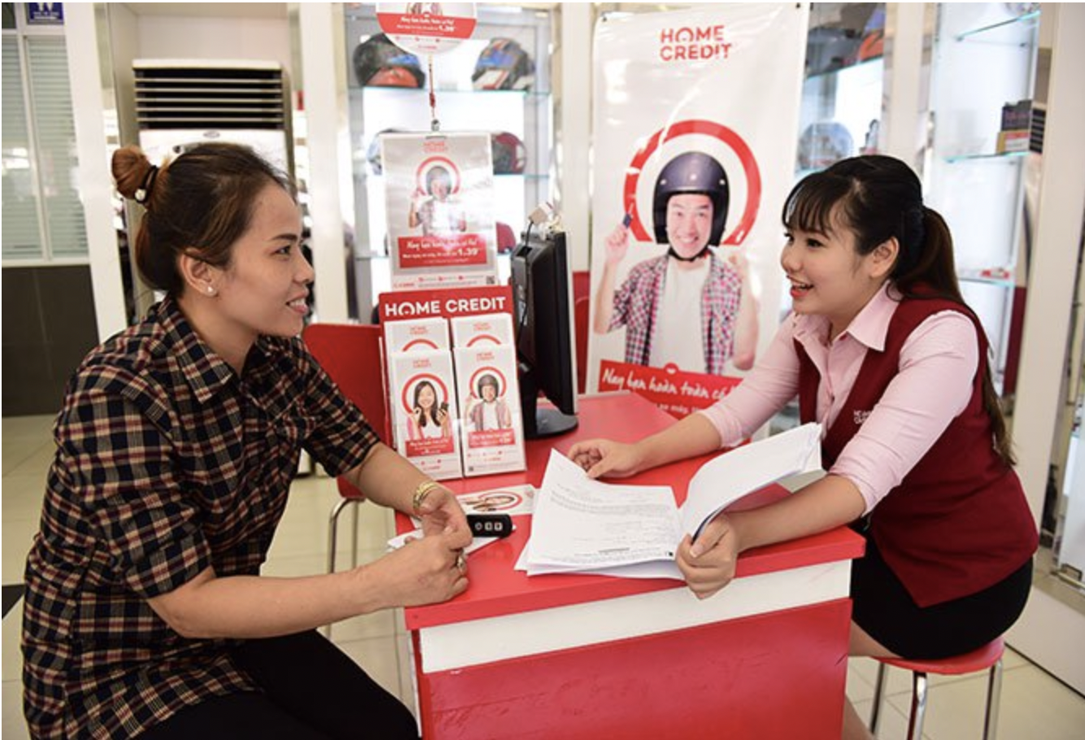
Part 1: Introduction
Many people struggle to get loans due to insufficient or non-existent credit histories. And, unfortunately, this population is often taken advantage of by untrustworthy lenders. This poses a huge danger of crime, such as usury, violence and so on. Home Credit company try to solve this issue by making use of a variety of alternative data.
Here, to help to unlock the full potential of data and make a better prediction of possible default people, we use different statistical and machine learning methods to achieve that goal.
Notes:
Firstly，I will briefly introduce the background of the project. Many people+读文字

Slide 4
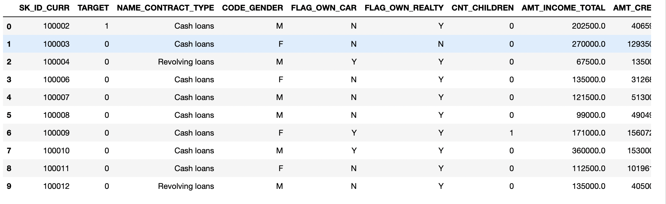
Part 2: Data Description
In the whole process, we mainly use data from ”Application_train.csv”- 122 variables and nearly 300k observations
The 122 variables in it can be broken into 5 categories: personal information of the customer, information about the loan, information about the area where the customer lives, the documents customer provided, and the inquiries made to the Credit Bureau
Notes:
Then I will introduce the data we use, and explore the structure of the data
The main data file is “Application_train.csv”, which contains 122 variables and nearly 300k observations. Other files also contain several other information, but due to the huge amount of data and information and more related variables in the main data file, we decide to pay more attention to the main file, and the 122 variables. The variable can be roughly divided into several parts of features: personal information, loan information, documents provided, and information from the Bureau.

Slide 5
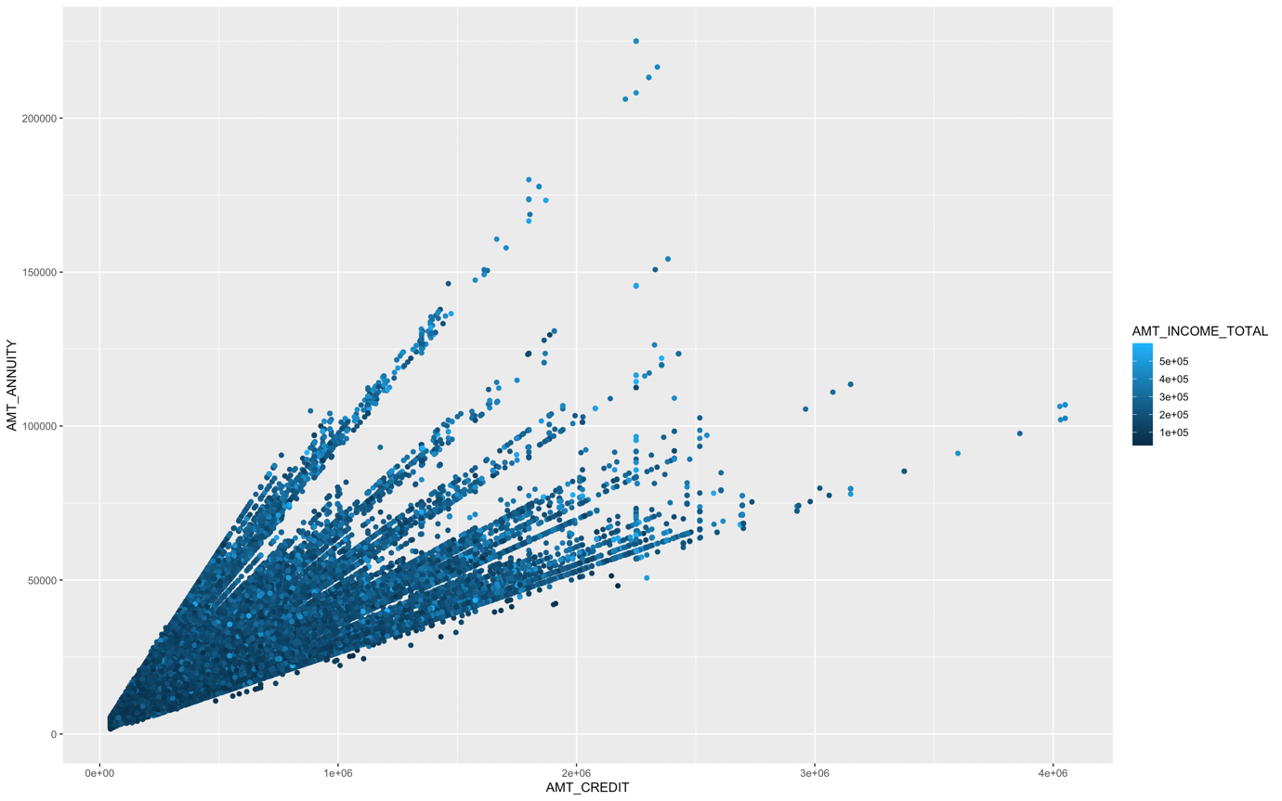
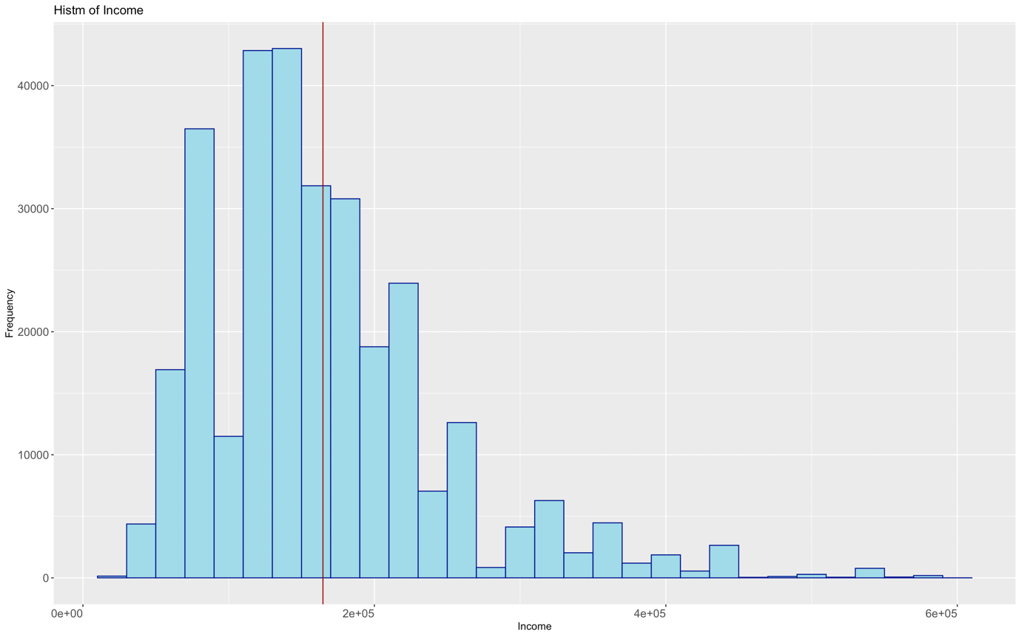
Part 2: Data Description
Data Exploration
A positive relationship between the amount of loan and loan annuity
The distribution clearly separates into several different lines with a mixture of different levels of income
Middle-income group makes up a large part of clients
Notes:
First, the plot compares the relationship between the total loan amount and loan annuity for Home Credit loan applicants. The distribution illustrates a positive relationship between two variables. Besides, the distribution is divergent. We can see from the figure that the distribution clearly separates into several different lines with a mixture of different levels of income.

Slide 6
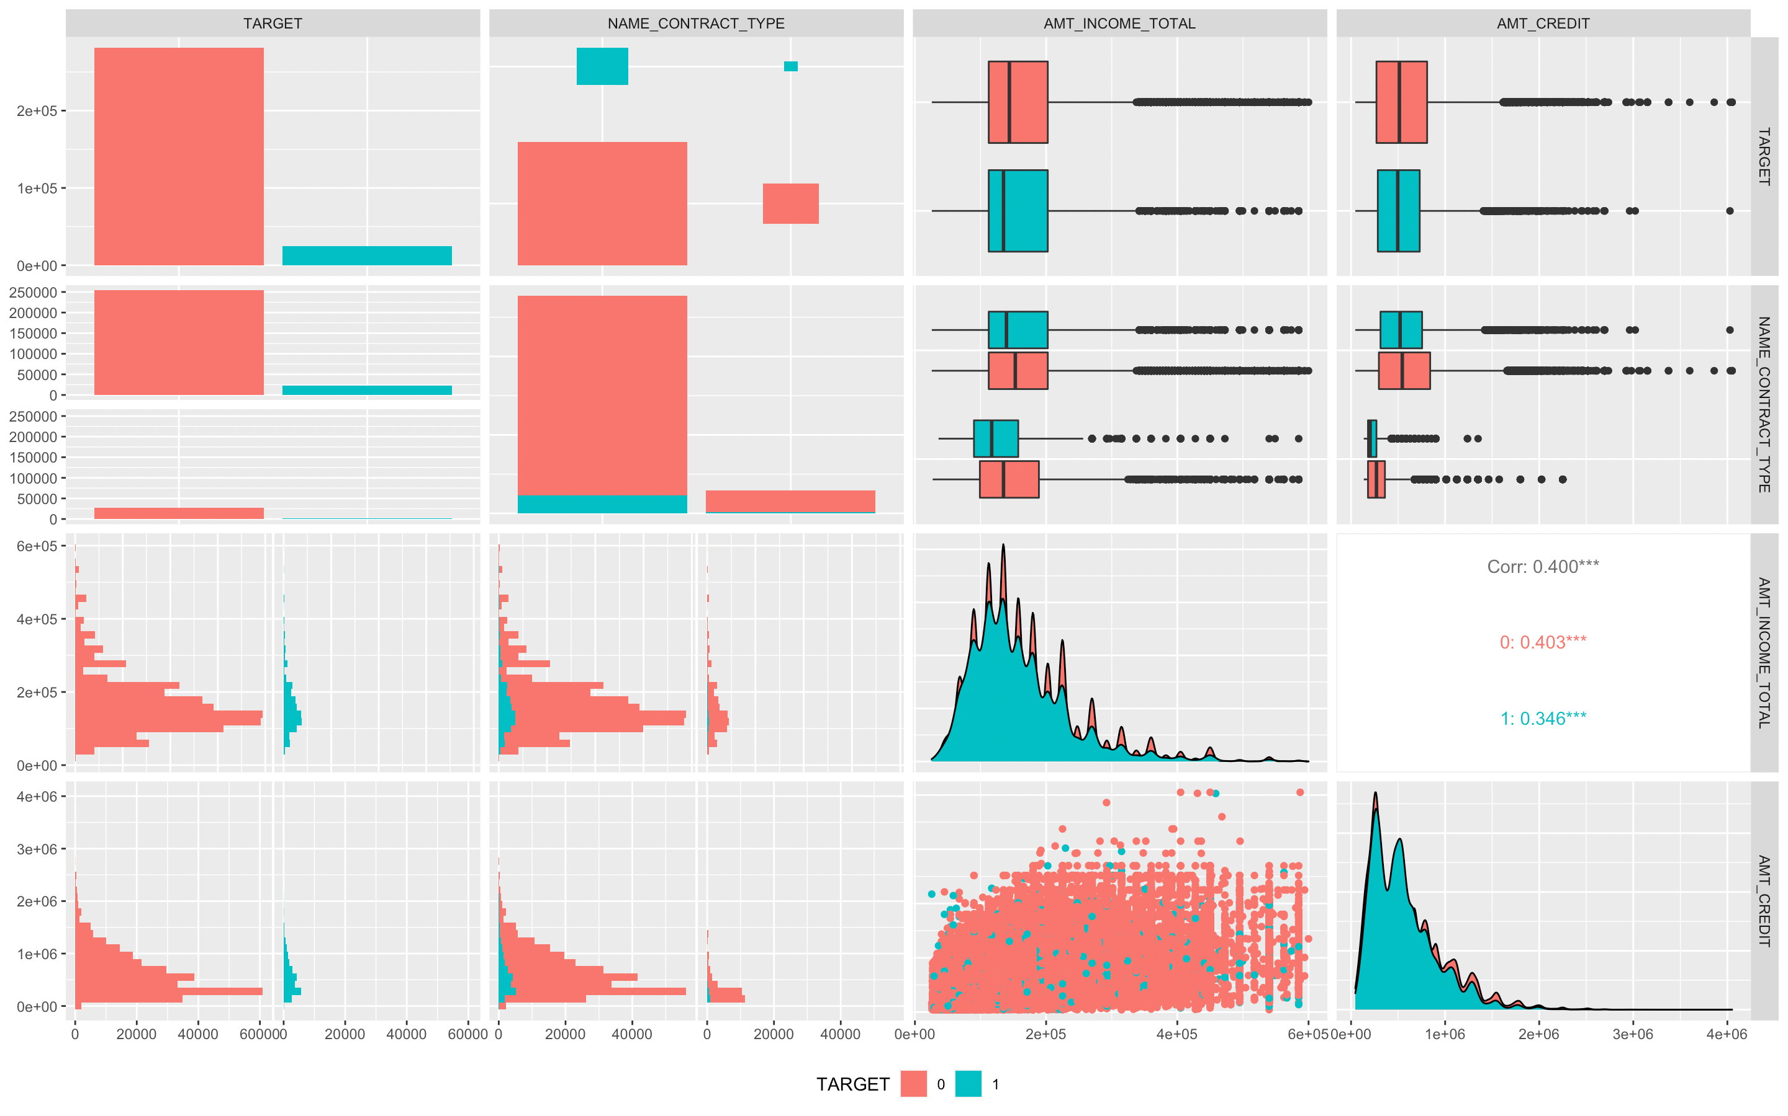
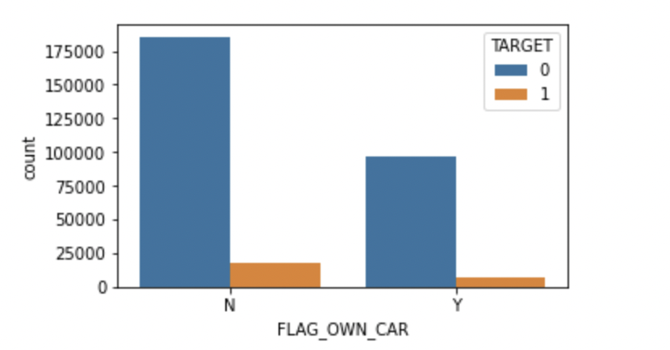
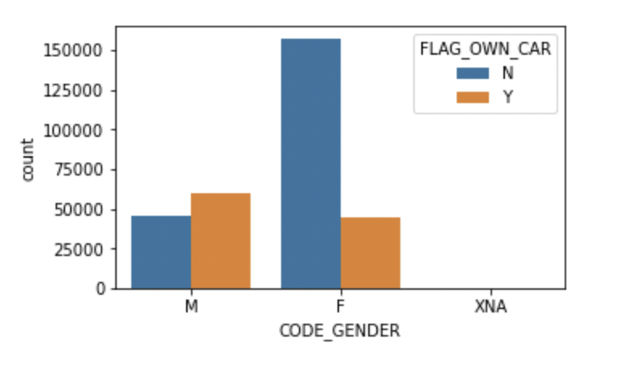
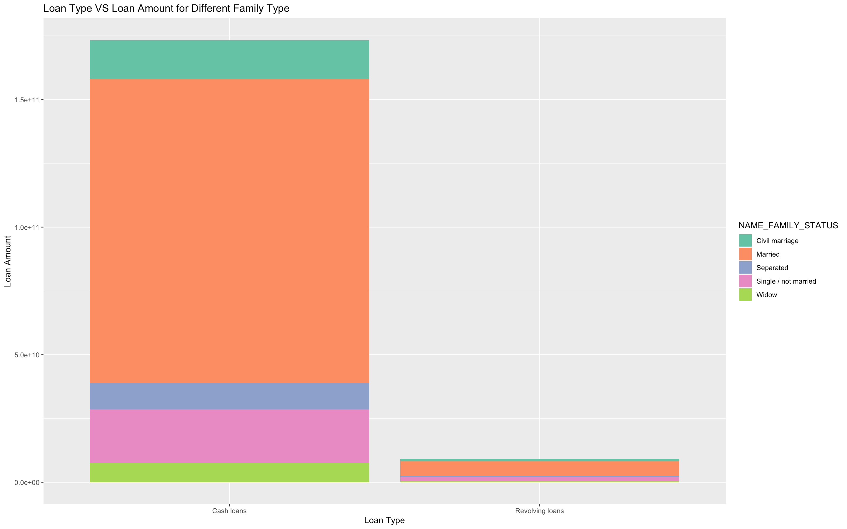
Part 2: Data Description
Notes:
The pairwise correlation matrix plot provides useful illustrations of relationships between our target variable (0 indicates not default and 1 indicates default) and several other variables (contract type, total income, total loan amount, etc.). From the matrix plot, we can interpret that no matter what type of contracts the customer has, the median income of the customers who did not default is higher than that of the customer who defaulted.
The stacked barplot on the left-hand side shows the total loan amount for different family types in different loan types. From the plot, we can interpret that the loan amount of revolving loans is much smaller compared to that of cash loans. Also, the majority portion of applicants for both cash loans and revolving loans are married people.
From the upper right boxplot, it indicate that the difference of the percentage of default and not default people is not huge in care owner and no car people. Though we normally think that car owners are more likely to pay the loansbecause they are richer
From the lower right part，the percentage of target=1 in males is 10.1% and in females is 7.0%. Men have a larger percentage of TARGET 1 than women, which means men have more percentage of people having difficulty paying. Gender has somehow effects on the target

Slide 7
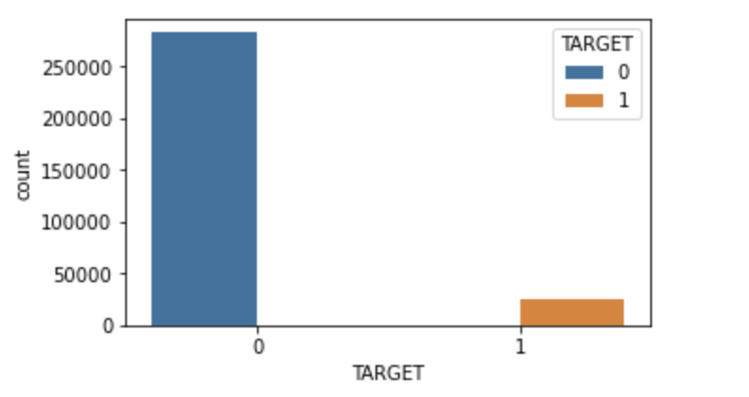
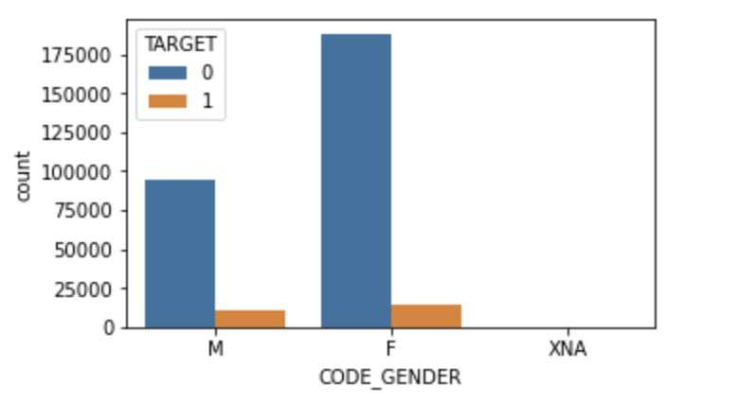
Part 2: Data Description
TARGET: 80% of 0 in data- Imbalanced data
GENDER: XNA value- Uncanonical value
Notes:
These two plots show that data may be imbalanced and some variables has few uncanonical values . The left plot shows that 80% of data is 0 which mean there are more observations from undefault clients. The right one reveal some outliers in Gender part, there are additional XNA values in gender rather than just male and female.
These findings are essential for the next part,the data preparation part, we should carefully deal with such kinds of variables.

Slide 8
Part 3: Methodology
Data Preparation
Modeling & Validation
Prediction
Notes:
The third part is the methodology, our project is divided into 3 parts. Data prep, modeling& validation , and prediction.

Slide 9
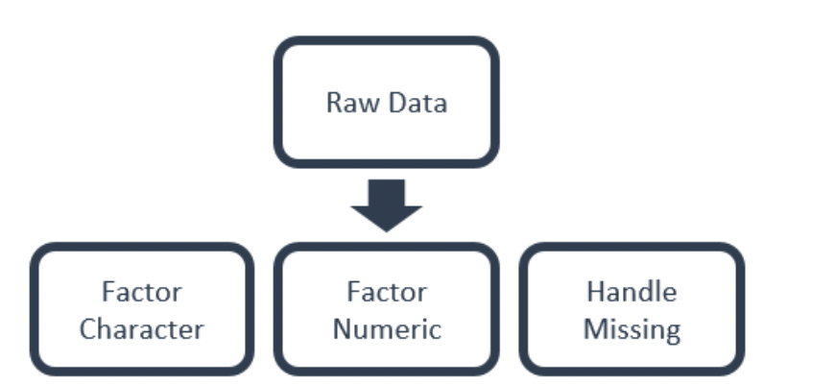
Part 3: Methodology- Data Preparation
Observations:
Drop some odd or vague observations. For instance: observations that do not have car age despite car ownership, observations that do not have valid gender type
Exclude some outliers
Variables:
Drop variables that are clearly unrelevant to the prediction. For instance: The ceiling mode of the house
Recode some variables into categorical values
Create Interaction Variables
Transform each variable into either character or numeric
Notes:
For the first step, data prep, we focus on observations and variables.
Then, to get more clear and essential observations for better training performance, some NA values, and some vague descriptions that neither fit in any valuable category of one variable, for example, the ‘XNA’ value in the gender column. Besides, to better quantify the data, some categorical variables are transformed into factors or numeric. Some categorical variables are recoded into binary values.

Slide 10
Part 3: Methodology- Modeling
Logistic regression
LightGBM (Light Gradient Boosting Machine) LightGBM is a gradient boosting framework that uses tree-based learning algorithms.
Classification and regression tree (CART)
Classification and regression tree (CART) with PCA
Evaluation method: K-fold cross-validation
Notes:
The third step is modeling and validation, we mainly use LR,ligthe GBM, CART,CART with PCA, and the validation method is 10 fold cross-validation

Slide 11
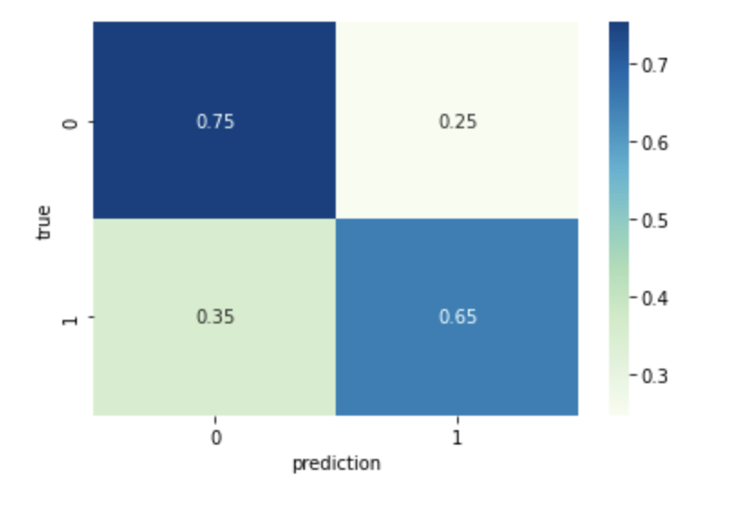
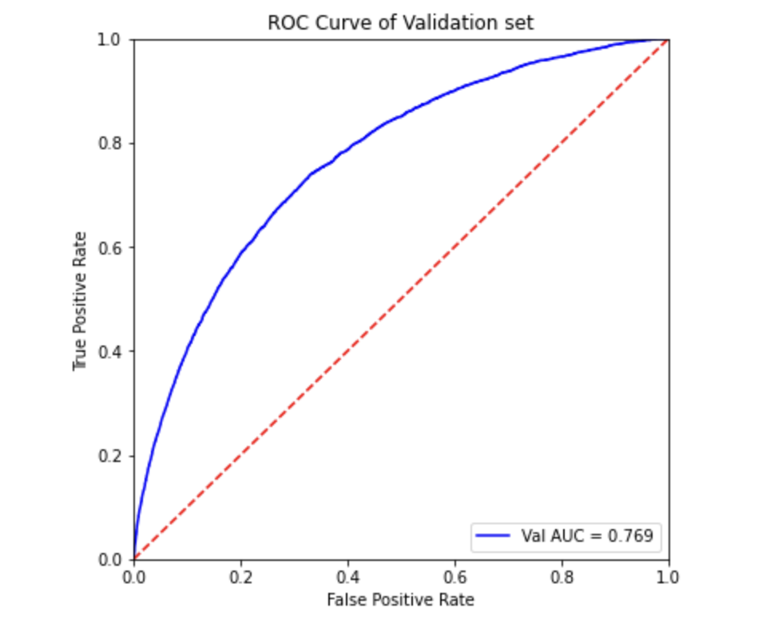
Part 4: Prediction
Logistic Regression Model
Confusion matrix
ROC curve
Notes:
The left plot is the confusion matrix of logistic regression model , and the threshold is 0.5, indicating the sensitivity and specificity
The right one is ROC curve, we can see that the AUC is roughly 0.76

Slide 12
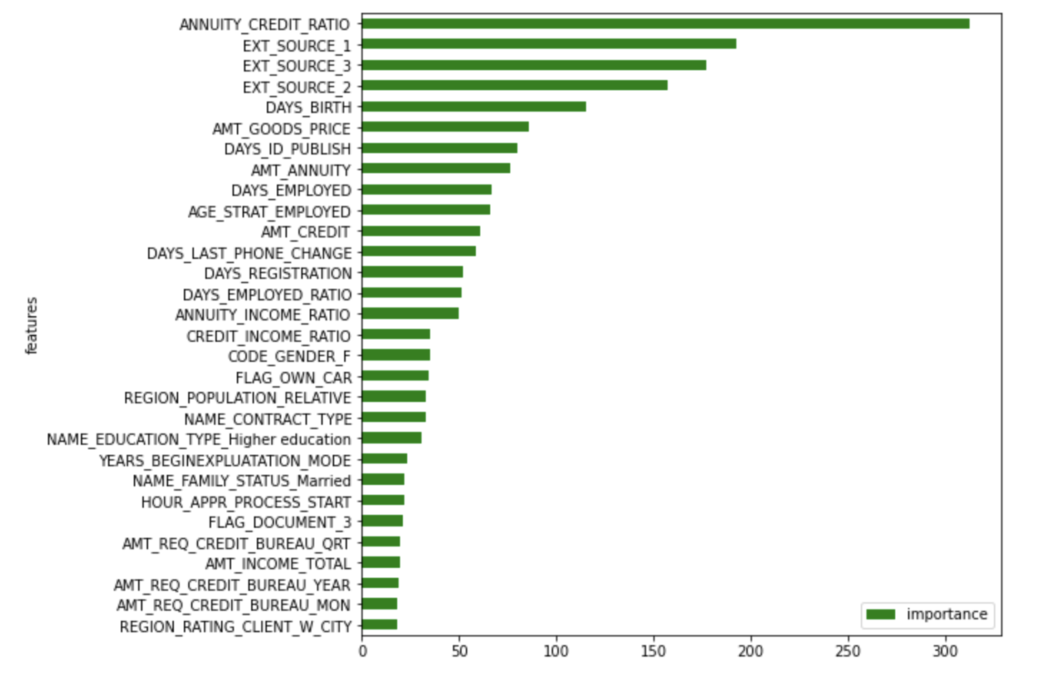
Part 4: Prediction
Notes:
This is the importance of variables, the annuity xx is the most important one in the model

Slide 13
Thanks!

